Slide 1


Slide 2






CREDIT CARD FRAUD Detection
BY
Royston Rodrigues

Slide 3

What is Credit Card Fraud?!
Phishing
E
X
A
M
P
L
E
S
Data Breaches
“An inclusive term for fraud committed using a payment card, such as a credit card or debit card.”
Account takeover
Hacking
Skimming
Why is Model important?!
What will be the impact of the Model?!
“To Predict whether the transactions are fraudulent or not”
Enhanced security, reduced financial losses, and improved customer trust

Slide 4





Data Collection
EDA
(Exploratory Data Analysis)
PREPROCESSING
SPLIT
TRAIN and TEST Data
Model Selection and
Model Training
Model Evaluation
WORK FLOW

Slide 5



DATASET
dd
Rows
Credit Card Fraud Detection Dataset 2023
5,68,630
Columns
31
Missing Value
Features
(Columns)
None
Duplicate Values
id : Unique identifier for each transaction
None
V1-V28 : Anonymized features representing various transaction attributes (e.g., time, location, etc.)
Amount : The transaction amount
Class: Binary label indicating whether the transaction is fraudulent (1) or not (0)

Slide 6

EDA
Exploratory Data Analysis
Exploratory Data Analysis is a data analysis approach that involves summarizing main characteristics of a dataset, often using visual methods, to understand its structure, identify patterns, and uncover potential relationships
df.info()
Gives a summary of the dataset including column names, data types, non-null values, and memory usage
df.dtypes
Returns the data type of each feature of a dataset.
Displays the first five rows of a dataset
df.head()
Displays the last five rows of dataset.
df.tail()
df.columns
Returns a list of column names in the dataset.
df.describe()
Gives descriptive statistics of a dataset

Slide 7
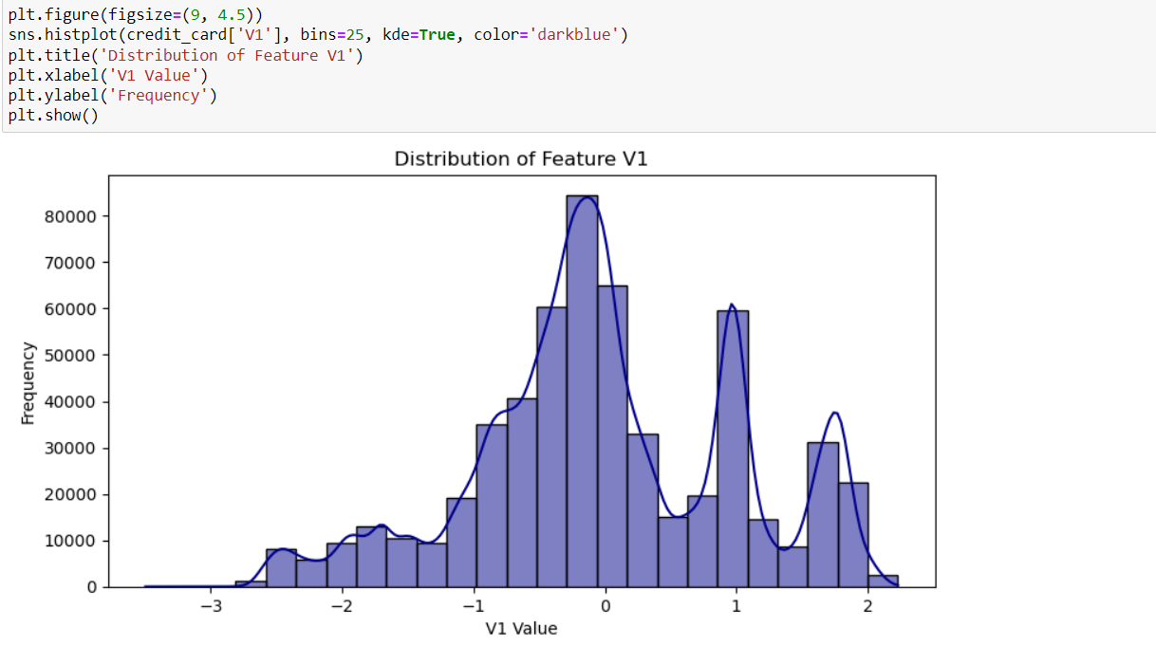
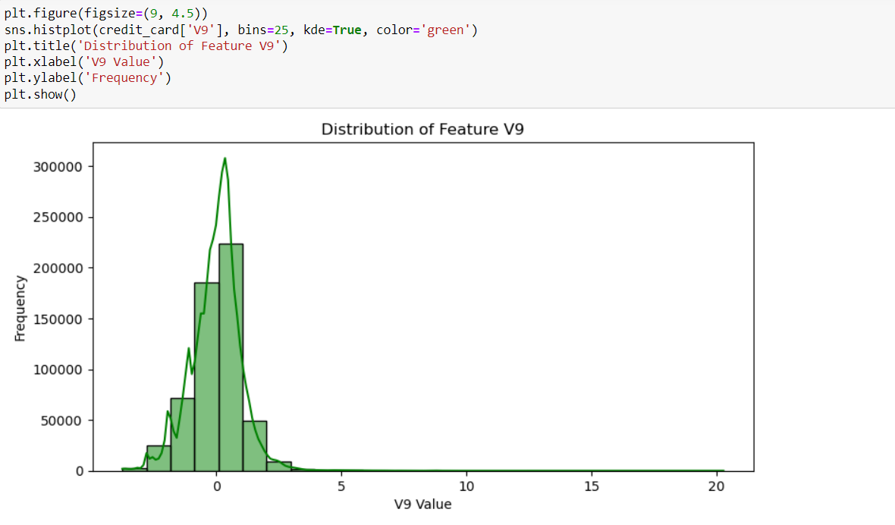
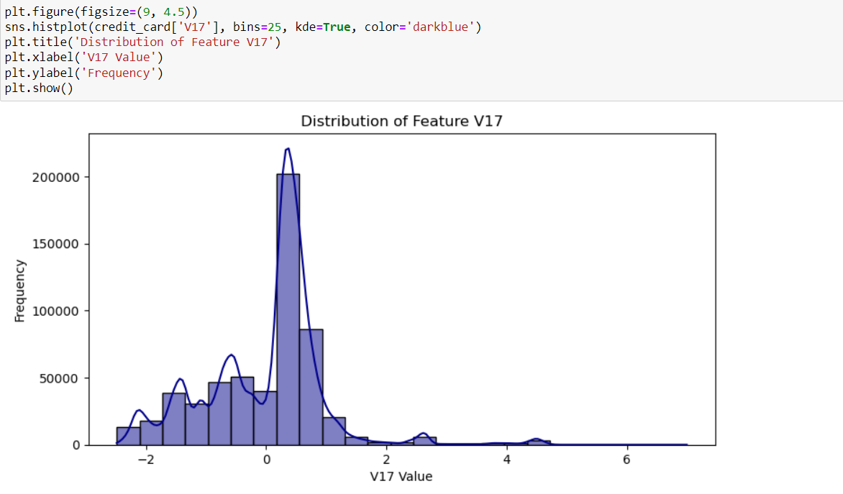
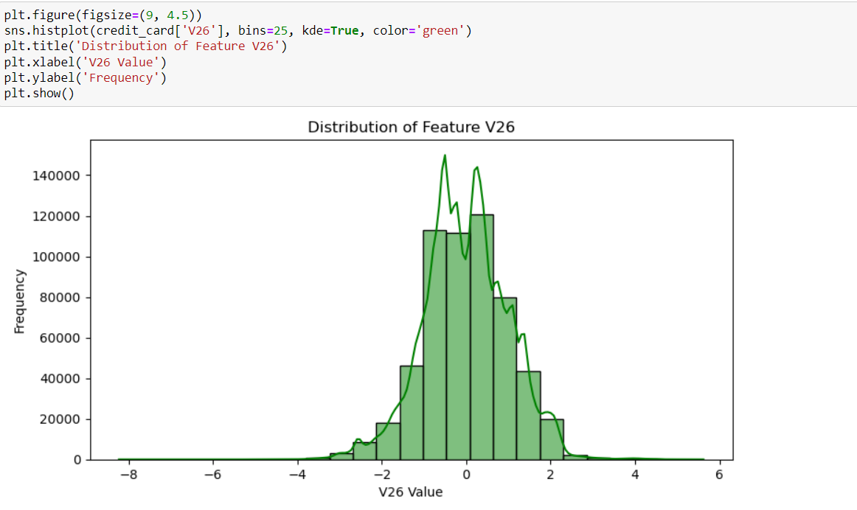
Observing the Distribution of Feature V1
Observing the Distribution of Feature V9
Observing the Distribution of Feature V17
Observing the Distribution of Feature V26

Slide 8
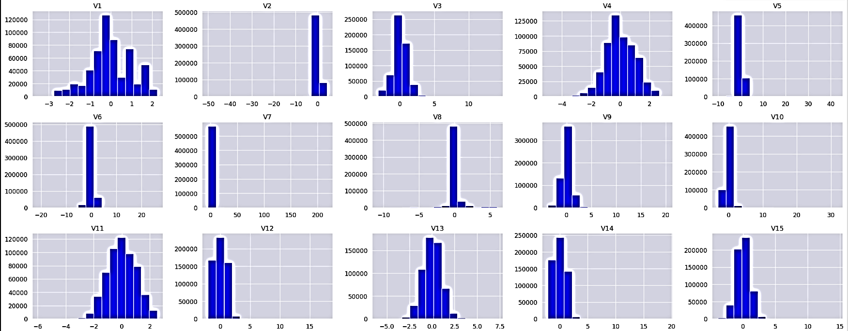
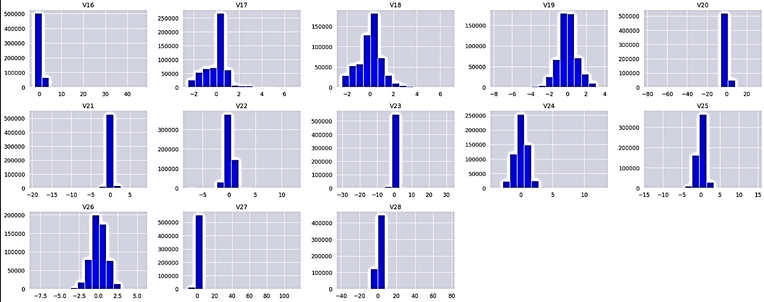
Observing the Distribution of Features
V1 – V15
V16 – V28

Slide 9
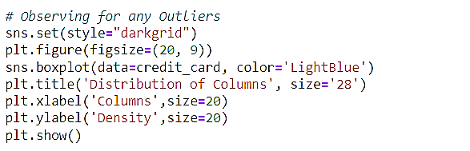
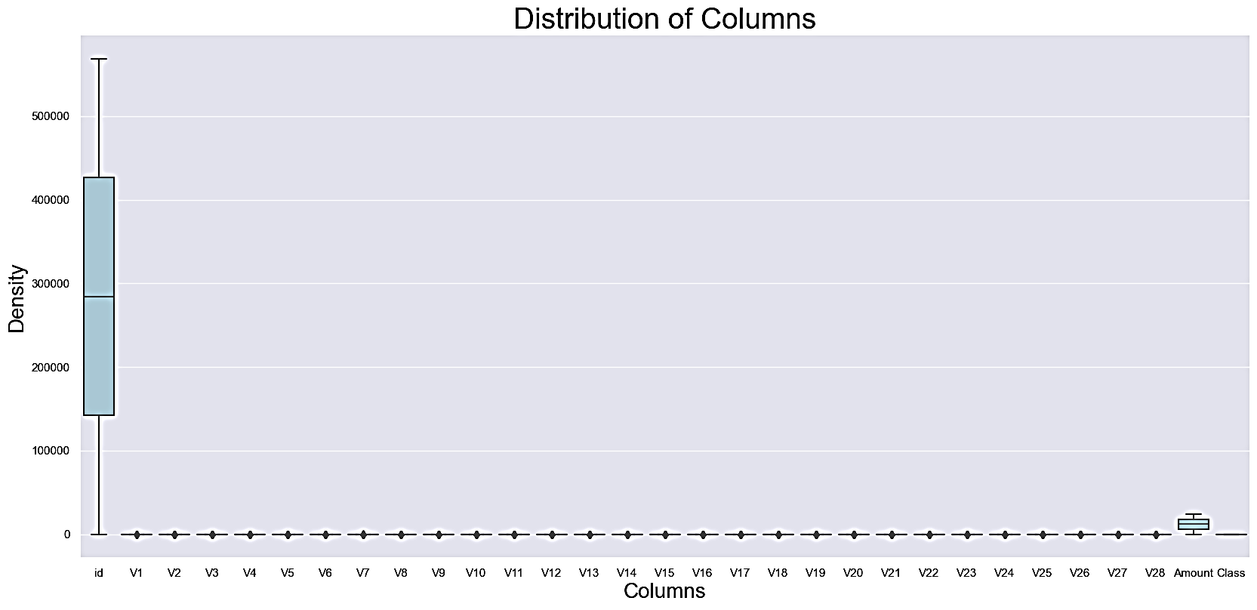
Observing the boxplot graph for ‘Outliers’
‘Outliers’ = None

Slide 10
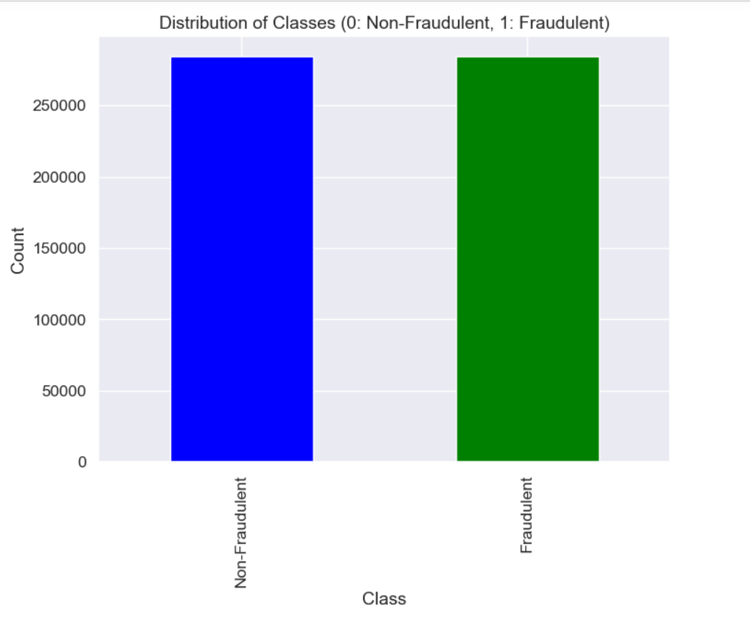
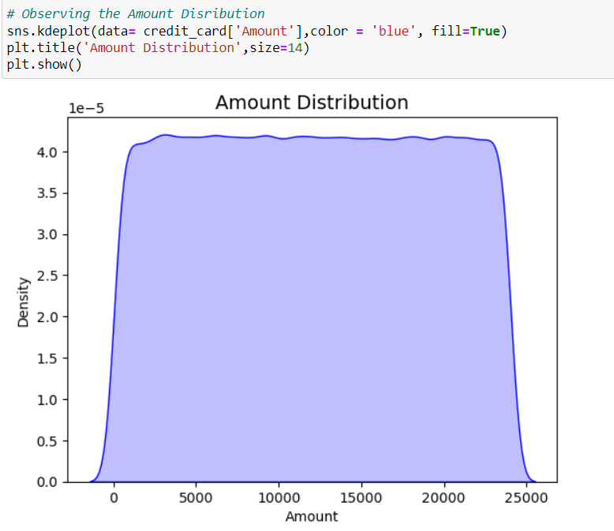
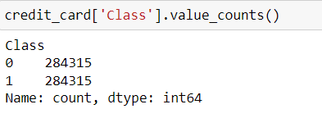
Observation of the Classes
0:Non fraudulent
1:Fradulent
Observation of Distribution of Amount
The feature ‘Class’ is evenly Balanced

Slide 11
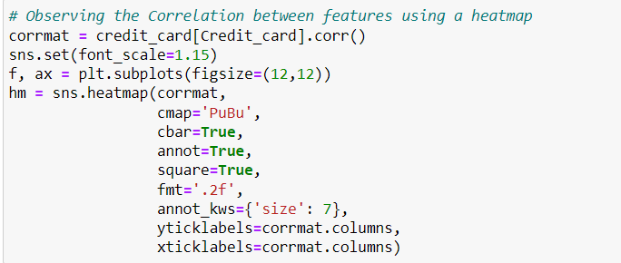
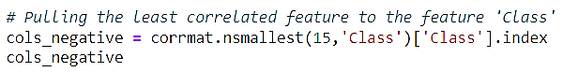
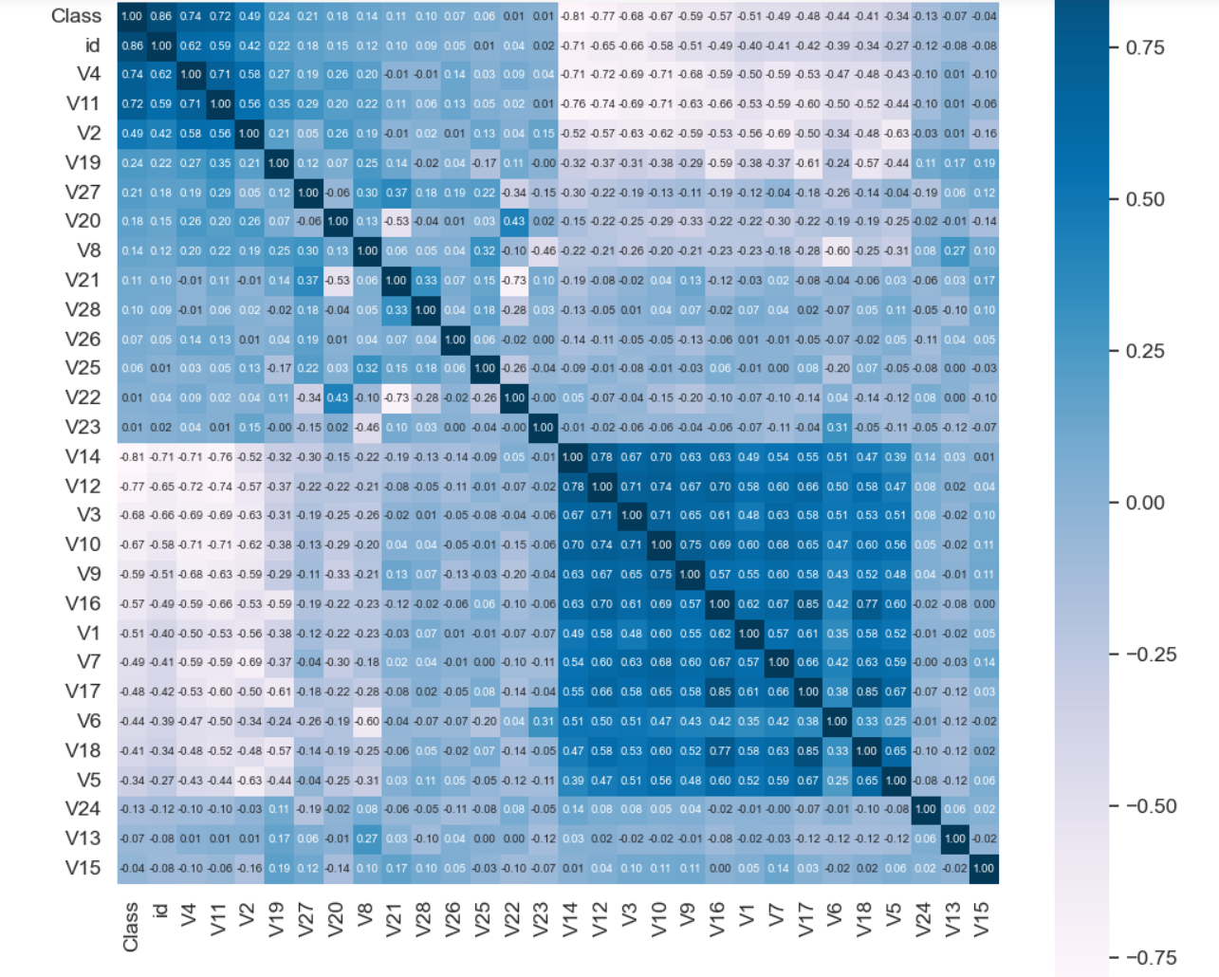
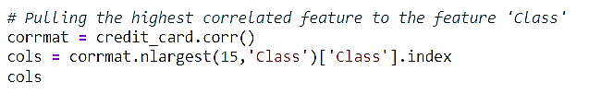
Heatmap to Understand the correlation between features

Slide 12
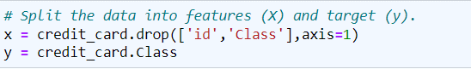
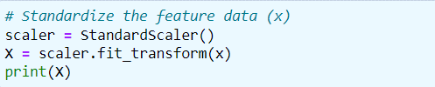


Dividing dataset into “ x ” and “ y ”
Standardize the feature data (x)
Dividing dataset into Training Data and Testing Data.

Slide 13
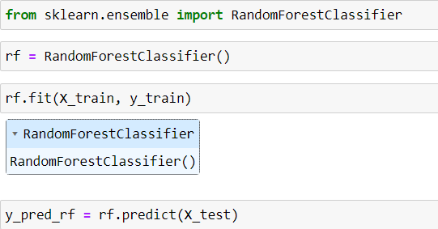
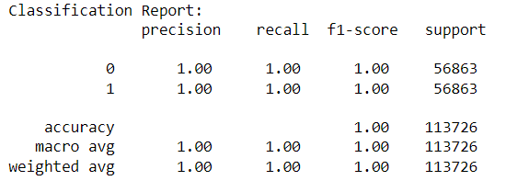
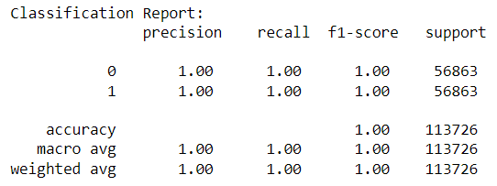
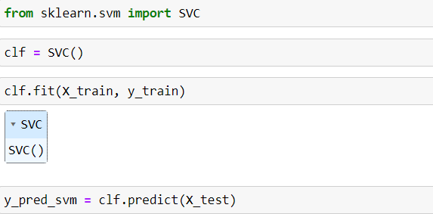
MODEL SELECTION AND TRAINING
Model
Classification report
RandomForestClassifier
Classification report
Model
Support Vector Machine (SVM)

Slide 14
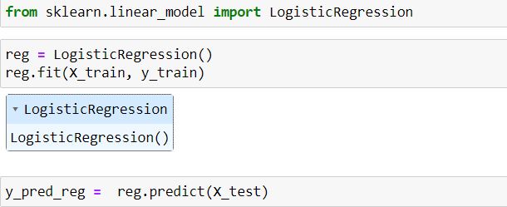
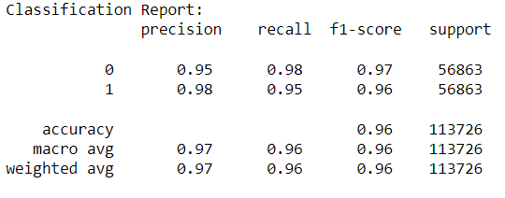
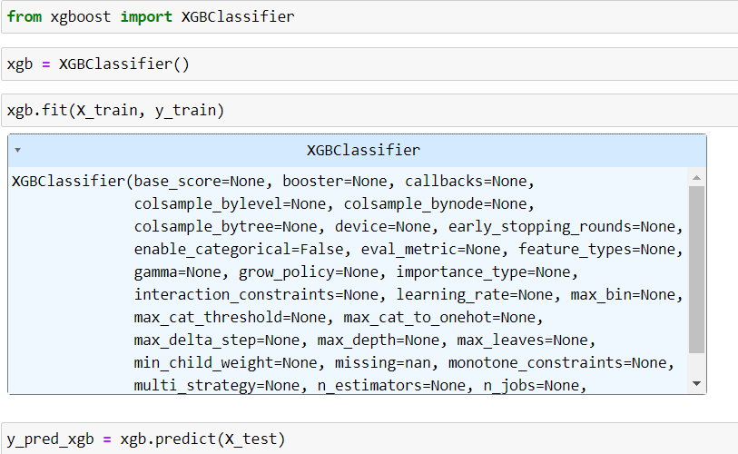
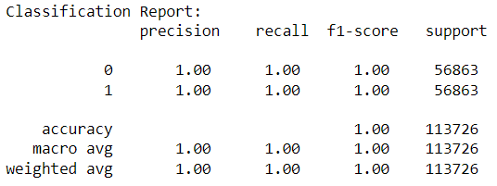
MODEL SELECTION AND TRAINING
Model
Classification report
Logistic Regression
Model
Classification report
Gradient Boosting Classifier (XGBoost)

Slide 15
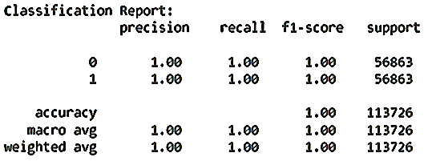
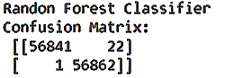
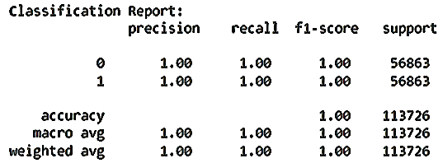
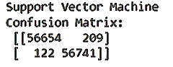
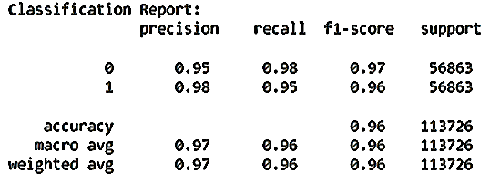
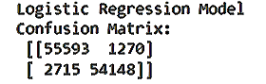
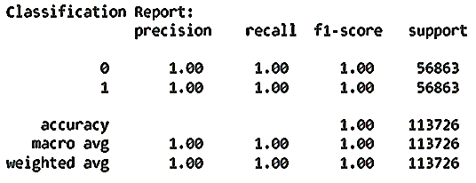
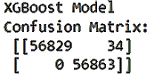
CAMPARISION
ALGORITHM | ACCURACY | CONFUSION MATRIX | CLASSIFICATTION REPORT
RandomForestClassifier | 99.979776%
Support Vector Machine (SVM) | 99.708950%
Logistic Regression | 96.495963%
Gradient Boosting Classifier (XGBoost) | 99.970103%

Slide 16
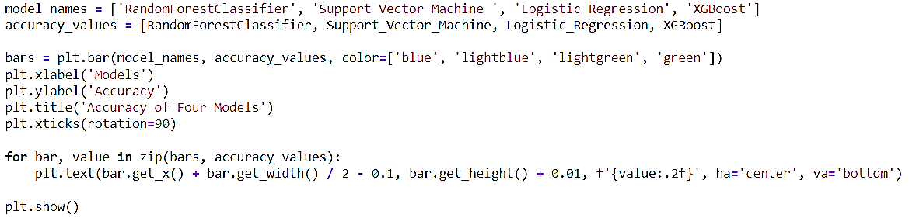
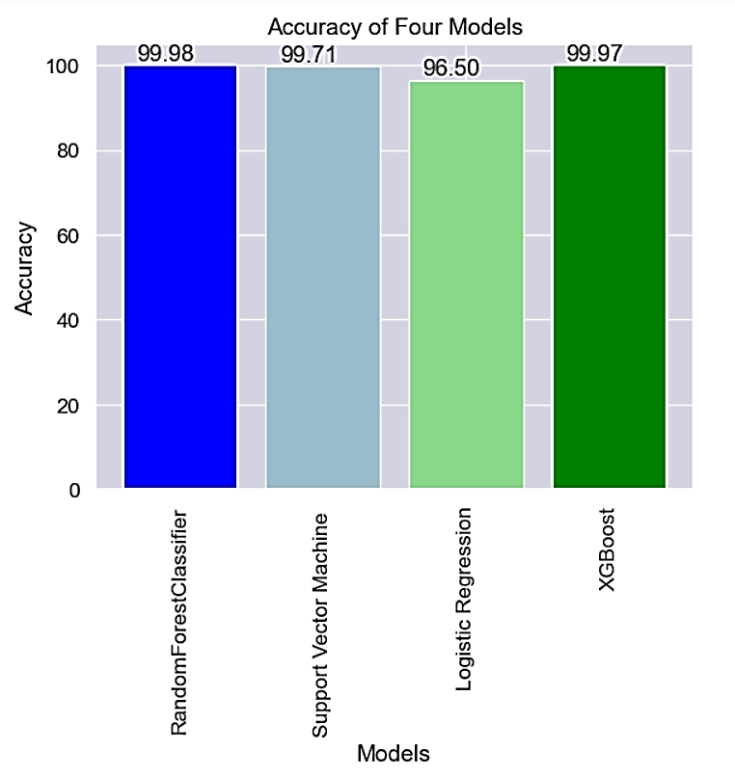

This shows that out of the 4 Models, the RainForestClassifier performs the best by returning the best accuracy
Summarizing the Accuracy Scores of the 4 Models

Slide 17
CONCLUSION
Reduced Financial Loss
Improved Authentication Measures:
Prevention of Reputation Damage
A Credit card Fraud detection model can provide valuable insights and support in Banking and Financial Service domain in the following ways:
Adaptive Learning:
Real-time Monitoring
Enhanced Customer Trust
Machine learning can be applied in various ways within the financial industry, including credit card processing and fraud detection:
Fraud Detection
Predictive Analytics for Delinquency and Defaults
Credit Scoring
Anomaly Detection
Customer Segmentation and Personalization
In Summary Machine learning in credit cards is an evolving field, and advancements in technology continue to shape how financial institutions manage risk, enhance customer experiences, and combat fraud.

Slide 18


Use Your Credit Card Wisely !

